Slide 1
CS326 Parallel and Distributed Computing
Fall 2021
National University of Computer and Emerging Sciences

Slide 2
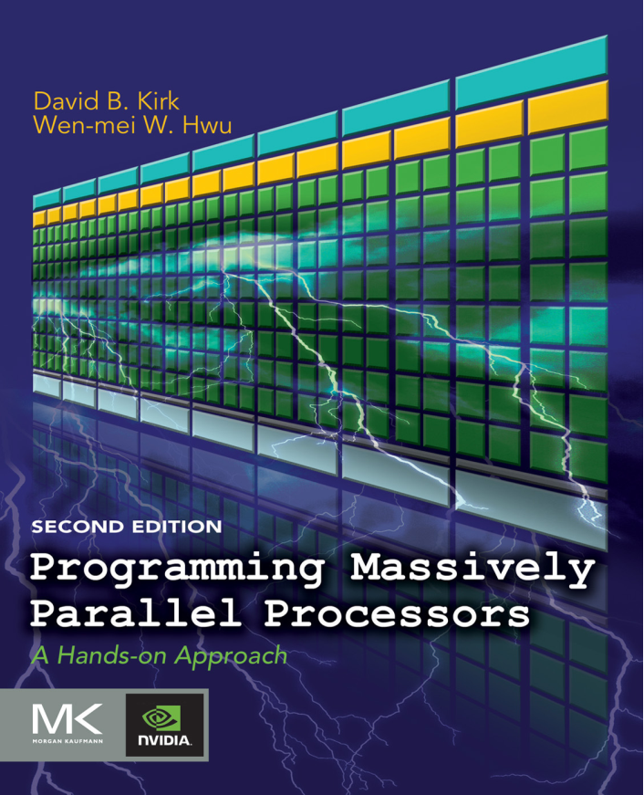
Reference Book (Chapter#4)
Programming Massively Parallel Processors
David B. Kirk
Wen-mei W. Hwu

Slide 3
Data-Parallel Execution Model

Slide 4
Fine-grained, data-parallel threads are the fundamental means of parallel execution in CUDA
Launching a CUDA kernel creates a grid of threads that all execute the kernel function.
The kernel function specifies the C statements that are executed by each individual thread at runtime
Each thread uses a unique coordinate, or thread index, to identify the portion of the data to process.
The thread index can be organized multi-dimensionally to facilitate access to multidimensional arrays
This chapter presents more details on the organization, resource assignment, synchronization, and scheduling of threads in a grid

Slide 5
4.1 CUDA THREAD ORGANIZATION
Recall, threads are organized into a two-level hierarchy:
a grid consists of one or more blocks and each block in turn consists of one or more threads
All threads in a block share the same block index, which can be accessed as the blockIdx variable in a kernel
Each thread also has a thread index, which can be accessed as the threadIdx variable in a kernel
To a CUDA programmer, blockIdx and threadIdx appear as built-in, preinitialized variables that can be accessed within kernel functions

Slide 6
In general, a grid is a 3D array of blocks and each block is a 3D array of threads.
The programmer can choose to use fewer dimensions by setting the unused dimensions to 1
The exact organization of a grid is determined by the execution configuration parameters (within <<< and >>>) of the kernel launch statement
The first execution configuration parameter specifies the dimensions of the grid in number of blocks, the second specifies the dimensions of each block in number of threads.
Notes:
dimensions are available as predefined built-in variables gridDim and blockDim in kernel functions

Slide 7
Each such parameter is of dim3 type, which is a C struct with three unsigned integer fields, x, y, and z; corresponding to the three dimensions
Example:
dim3 dimBlock(128, 1, 1);
dim3 dimGrid(32, 1, 1);
vecAddKernel <<<dimGrid, dimBlock>>> (...)
Note that dimBlock and dimGrid are host code variables defined by the programmer
Notes:
In CUDA C, the allowed values of gridDim.x, gridDim.y, and gridDim.z range from 1 to 65,536. All threads in a block share the same blockIdx.x, blockIdx.y, and blockIdx.z values

Slide 8
Blocks are organized into 3D arrays of threads
Two-dimensional blocks can be created by setting the z dimension to 1.
One-dimensional blocks can be created by setting both the y and z dimensions to 1, as in the vectorAddkernel example.
The total size of a block is limited to 1,024 threads, with flexibility in distributing these elements into the three dimensions as long as the total number of threads does not exceed 1,024
For example, (512, 1, 1), (8, 16, 4), and (32, 16, 2) are all allowable blockDim values, but (32, 32, 2) is not allowable since the total number of threads would exceed 1,024

Slide 9
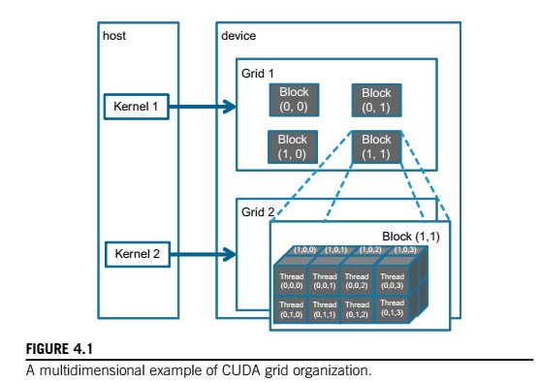

Notes:
Note that the grid can have higher dimensionality than its blocks and vice versa

Slide 10
The grid consists of four blocks organized into a 2 X 2 array.
Each block in Figure 4.1 is labeled with (blockIdx.y, blockIdx.x). For example, block(1,0) has blockIdx.y 5 1 and blockIdx.x 5 0. Note that the ordering of the labels is such that the highest dimension comes first. This is reverse of the ordering used in the configuration parameters where the lowest dimension comes first.

Slide 11
4.2 MAPPING THREADS TO MULTIDIMENSIONAL DATA
The choice of 1D, 2D, or 3D thread organizations is usually based on the nature of the data.
For example, pictures are a 2D array of pixels.
It is often convenient to use a 2D grid that consists of 2D blocks to process the pixels in a picture

Slide 12
Example:
Consider processing a 76 X 62 picture (76 pixels in the horizontal or x direction and 62 pixels in the vertical or y direction).
Assume that we decided to use a 16 X 16 block
We will need five blocks in the x direction and four blocks in the y direction, which results in 5 X 4 = 20 blocks
Note that we have four extra threads in the x direction and two extra threads in the y direction. That is, we will generate 80 X 64 threads to process 76 X 62 pixels.

Slide 13
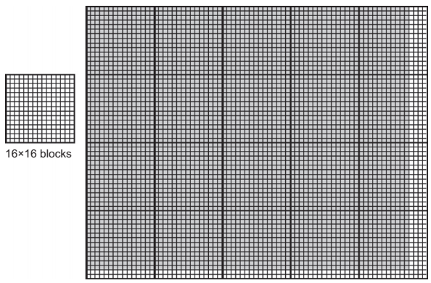

Slide 14
We should expect that the picture processing kernel function will have if statements to test whether the thread indices threadIdx.x and threadIdx.y fall within the valid range of pixels

Slide 15
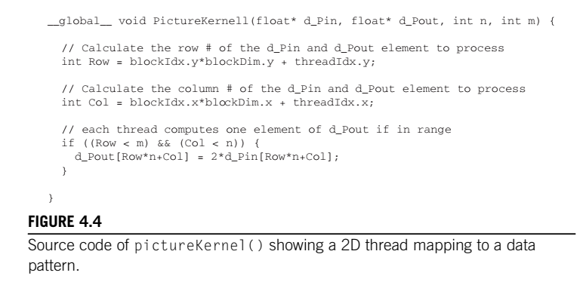

Slide 16
Assuming that we use 16 X 16 blocks, launching pictureKernel() generates 80 X 64 threads.
The grid will have 20 blocks, 5 in the horizontal direction and 4 in the vertical direction.
During the execution, the execution behavior of blocks will fill into one of four different cases, shown as four major areas.
The first area consists of the threads that belong to the 12 blocks covering the majority of pixels in the picture.
Both Col and Row values of these threads are within range; all these threads will pass the if statement test and process pixels in the darkshaded area of the picture.

Slide 17
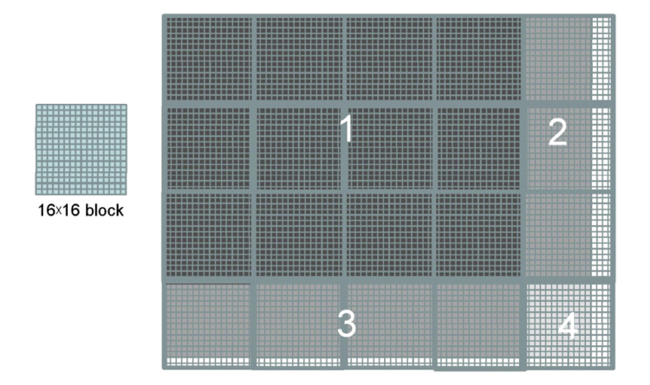

Slide 18
The second area, marked as 2 in Figure 4.5
Although the Row values of these threads are always within range, the Col values of some of them exceed the n value (76)
The smallest multiple of 16 needed to cover 76 pixels is 80. As a result, 12 threads in each row will find their Col values within range and will process pixels.
On the other hand, 4 threads in each row will find their Col values out of range, and thus fail the if statement condition.

Slide 19
The third area, accounts for the 3 lower-left blocks covering the medium-shaded area of the picture.
Although the Col values of these threads are always within range, the Row values of some of them exceed the m value (62)
This is because the number of threads in the vertical direction is always multiples of the blockDim.y value chosen by the programmer (16 in this case).
The smallest multiple of 16 to cover 62 is 64. As a result, 14 threads in each column will find their Row values within range and will process pixels.

Slide 20
The fourth area, marked as 4 in Figure 4.5, contains the threads that cover the lower-right light-shaded area of the picture.
Similar to area 2, 4 threads in each of the top 14 rows will find their Col values out of range.
Similar to area 3, the entire bottom two rows of this block will find their Row values out of range.
So, only 14 X 12 = 168 of the 16 X 16 = 256 threads will be allowed to process threads

Slide 21
4.4 SYNCHRONIZATION AND TRANSPARENT SCALABILITY
CUDA allows threads in the same block to coordinate their activities using a barrier synchronization function __syncthreads()
all threads in a block will be held at the calling location until every thread in the block reaches the location
This ensures that all threads in a block have completed a phase of their execution of the kernel before any of them can move on to the next phase
A __syncthreads() statement, if present, must be executed by all threads in a block.
When a __syncthread() statement is placed in an if statement, either all threads in a block execute the path that includes the __syncthreads() or none of them does

Slide 22
For an if-then-else statement, if each path has a __syncthreads() statement, either all threads in a block execute the __syncthreads() on the then path or all of them execute the else path.
The two __syncthreads() are different barrier synchronization points. If a thread in a block executes the then path and another executes the else path, they would be waiting at different barrier synchronization points.
They would end up waiting for each other forever.
It is the responsibility of the programmers to write their code so that these requirements are satisfied.

Slide 23
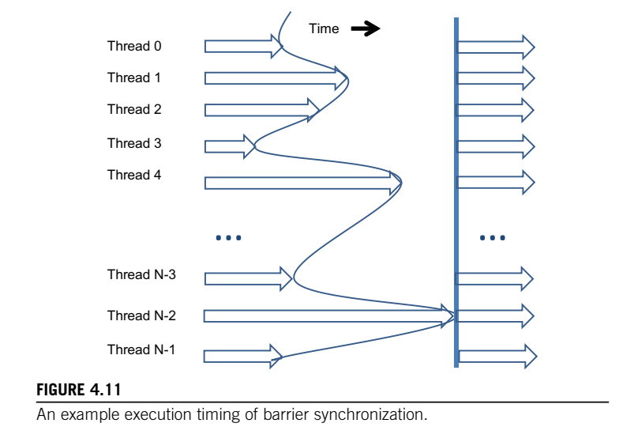

Slide 24
The ability to synchronize also imposes execution constraints on threads within a block. These threads should execute in close time proximity with each other to avoid excessively long waiting times.
In fact, one needs to make sure that all threads involved in the barrier synchronization have access to the necessary resources to eventually arrive at the barrier. Otherwise, a thread that never arrived at the barrier synchronization point can cause everyone else to wait forever.
CUDA runtime systems satisfy this constraint by assigning execution resources to all threads in a block as a unit. A block can begin execution only when the runtime system has secured all the resources needed for all threads in the block to complete execution.

Slide 25
Transparent scalability for CUDA Programs
CUDA runtime system can execute blocks in any order relative to each other since none of them need to wait for each other. This flexibility enables scalable implementations as shown in Figure 4.12, where time progresses from top to bottom.
In a low-cost system with only a few execution resources, one can execute a small number of blocks at the same time; two blocks executing at a time is shown on the left side of Figure 4.12.
In a high-end implementation with more execution resources, one can execute a large number of blocks at the same time; four blocks executing at a time is shown on the right side of Figure 4.12.

Slide 26
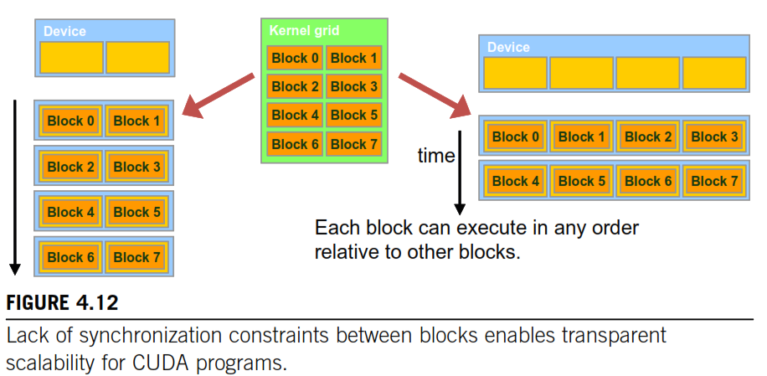

Slide 27
Transparent Scalability
The ability to execute the same application code at a wide range of speeds allows the production of a wide range of implementations according to the cost, power, and performance requirements of particular market segments.
For example, a mobile processor may execute an application slowly but at extremely low power consumption, and a desktop processor may execute the same application at a higher speed while consuming more power. Both execute exactly the same application program with no change to the code.
The ability to execute the same application code on hardware with a different number of execution resources is referred to as transparent scalability, which reduces the burden on application developers and improves the usability of applications.

Slide 28
4.5 ASSIGNING RESOURCES TO BLOCKS
Once a kernel is launched, the CUDA runtime system generates the corresponding grid of threads. As we discussed in the previous section, these threads are assigned to execution resources on a block-by-block basis. In the current generation of hardware, the execution resources are organized into streaming multiprocessors (SMs).
Figure 4.13 illustrates that multiple thread blocks can be assigned to each SM.
Each device has a limit on the number of blocks that can be assigned to each SM. For example, a CUDA device may allow up to eight blocks to be assigned to each SM.

Slide 29
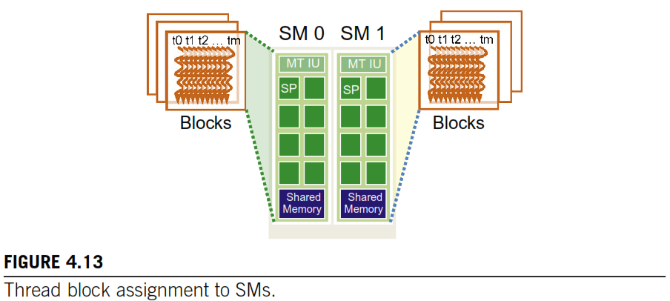
MT IU (multithreaded instruction unit)
SP : Streaming Processor
SM: Streaming Multiprocessor

Slide 30
In situations where there is an insufficient amount of any one or more types of resources needed for the simultaneous execution of eight blocks, the CUDA runtime automatically reduces the number of blocks assigned to each SM until their combined resource usage falls under the limit.
One of the SM resource limitations is the number of threads that can be simultaneously tracked and scheduled. It takes hardware resources for SMs to maintain the thread and block indices and track their execution status. In more recent CUDA device designs, up to 1,536 threads can be assigned to each SM.

Slide 31
This could be in the form of 6 blocks of 256 threads each, 3 blocks of 512 threads each, etc. If the device only allows up to 8 blocks in an SM, it should be obvious that 12 blocks of 128 threads each is not a viable option.
If a CUDA device has 30 SMs and each SM can accommodate up to 1,536 threads, the device can have up to 46,080 threads simultaneously residing in the CUDA device for execution.

